Slide 1
DTS207TC Week Lab W6
Hejia Qiu
Assistant Professor in AIAC
Email: Hejia.Qiu@XJTLU.EDU.CN
Office Hour: D-5020
Tuesday & Thursday 2-4 PM

Slide 2
Week 6: Hadoop
- Installing VirtualBox + Ubuntu + Hadoop (Single Node Mode)
- Try Map Reduce on Hadoop in Python
Week 7: Data Warehousing

Slide 3
W6
Hadoop for Big Data

Slide 4
Objectives (2 Hours)
🎯 By the end of this tutorial, you will be able to:
  Install and run Oracle VirtualBox
  Set up Ubuntu Linux as a virtual machine
  Configure Hadoop in pseudo-distributed (single-node) mode
  Run MapReduce examples on Hadoop in Python

Slide 5
Overview of the Big Data Stack
🧱 Layers:
  OS: Ubuntu
  Framework: Hadoop
  Storage: HDFS
  Processing: MapReduce
Focus today: Single-node mode = all on one VM

Slide 6
Step 1 – Download & Install VirtualBox
🌐 https://www.virtualbox.org
✅ Choose version for your OS (Windows, macOS, Linux)
🛠️ Run the installer and follow the default settings
If you are using Lab PC, it is already installed.
We strongly suggest you to use Lab PC today.

Slide 7

Step 1 – Download & Install VirtualBox
🌐 https://www.virtualbox.org
✅ Choose version for your OS (Windows, macOS, Linux)
🛠️ Run the installer and follow the default settings

Slide 8


Slide 9
Step 2 – Download Ubuntu ISO
Due to the time limitation, we use the OVA file to skip all the configuration of Ubuntu and Hadoop.
Download all the zip files and extract to one OVA file. Then import it into the VirtualBox. Use Lab PC if your laptop is a MacBook.
https://box.xjtlu.edu.cn/d/bece1aa3b83d4c93a1cb/

Slide 10

Download all zip files one-by-one

Slide 11





If you are using own Windows laptop, try 7-Zip or WinRAR for OVA extraction.

Slide 12

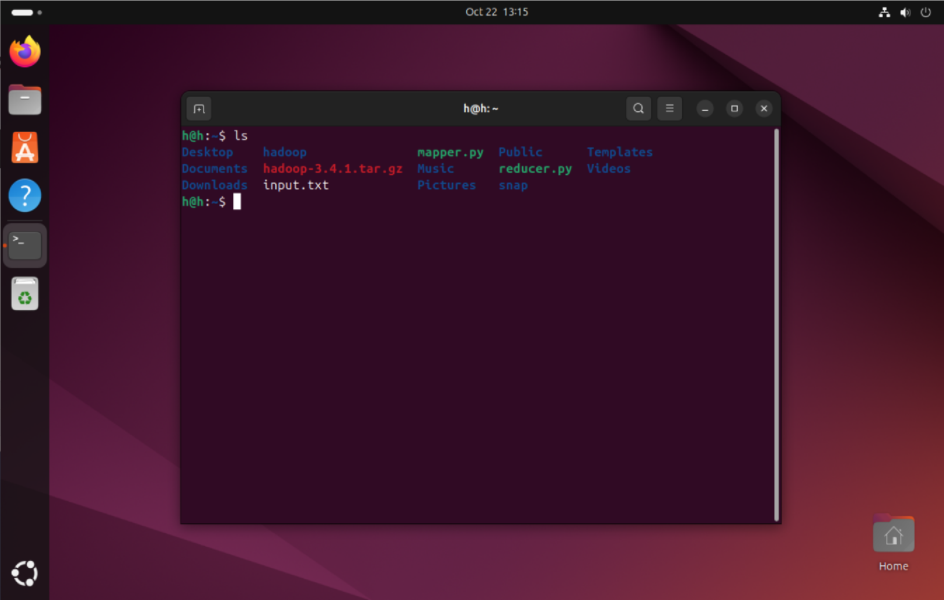
User: h Password: 123

Slide 13
Step 3 – Format the Namenode
Initialize Hadoop filesystem:
✅ Only do this once after initial configuration
hdfs namenode -format

Slide 14
Step 4 – Start HDFS Services
✅ Check with:
You should see NameNode, DataNode, SecondaryNameNode.
start-dfs.sh
jps

Slide 15
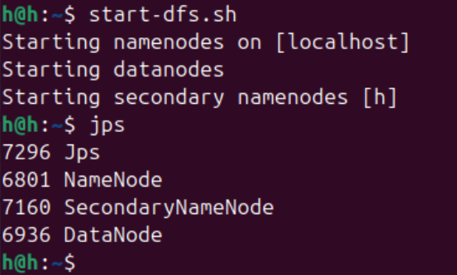
Start HDFS Services

Slide 16
Step 5 – Start YARN Services
✅ Check with:
You should see ResourceManager, NodeManager.
start-yarn.sh
jps

Slide 17
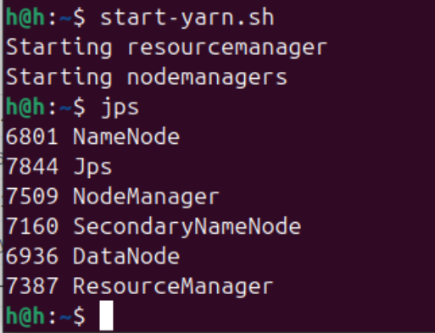
Start YARN Services

Slide 18
Access Hadoop Web UI
🌐 In browser (from host machine or inside VM):
  HDFS: http://localhost:9870
  YARN: http://localhost:8088
🧠 Useful for debugging & monitoring

Slide 19
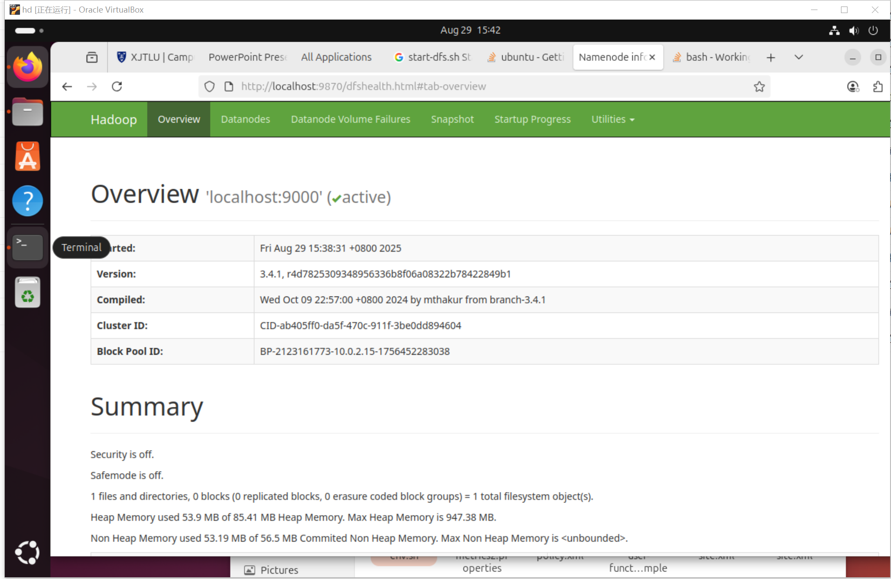
Access Hadoop Web UI

Slide 20
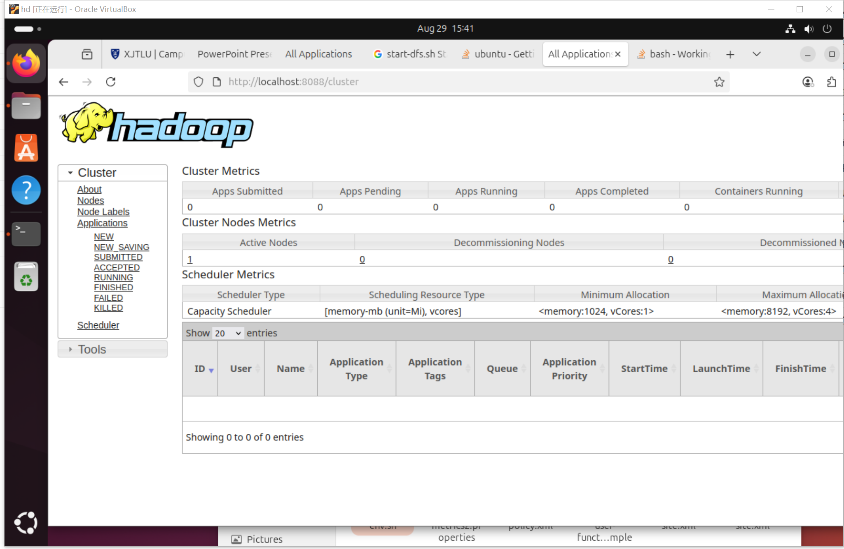
Access Hadoop Web UI

Slide 21
Step 6 – Test with Sample File
hdfs dfs -mkdir /test
hdfs dfs -put ~/.bashrc /test
hdfs dfs -ls /test
Pay attention to the space between commands!
✅ If output shows uploaded file → setup is working

Slide 22
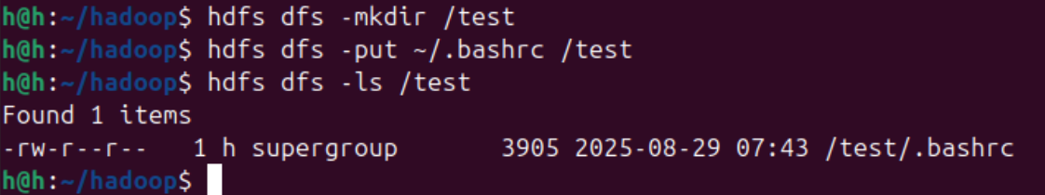
Test with Sample File
✅ If output shows uploaded file → setup is working

Slide 23
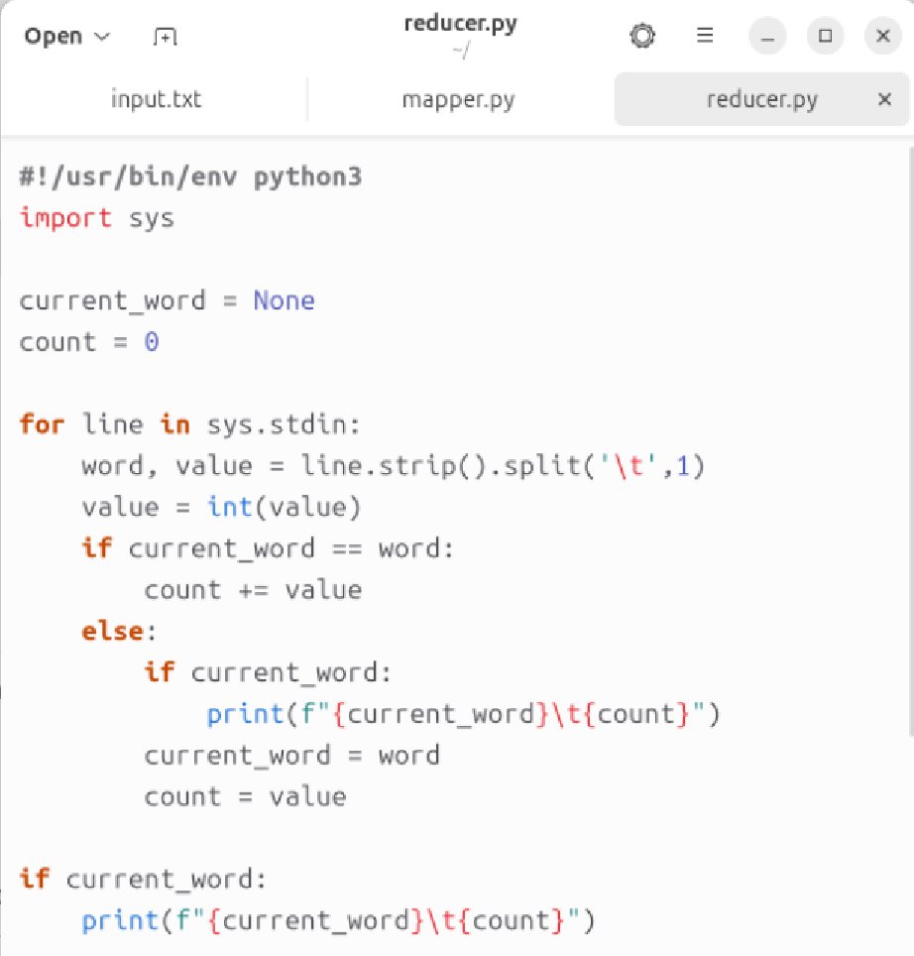
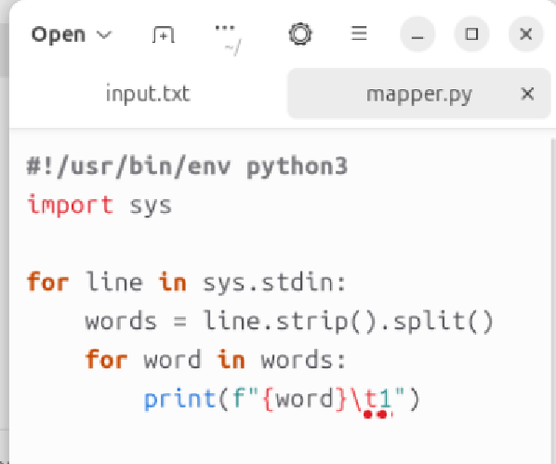
Step 7 – Try MapReducer in Ubuntu
Create mapper.py and reducer.py – word count example

Slide 24
#!/usr/bin/env python3
import sys
for line in sys.stdin:
words = line.strip().split()
for word in words:
print(f"{word}\t1")
#!/usr/bin/env python3
import sys
current_word = None
count = 0
for line in sys.stdin:
word, value = line.strip().split('\t', 1)
value = int(value)
if current_word == word:
count += value
else:
if current_word:
print(f"{current_word}\t{count}")
current_word = word
count = value
if current_word:
print(f"{current_word}\t{count}")

Slide 25
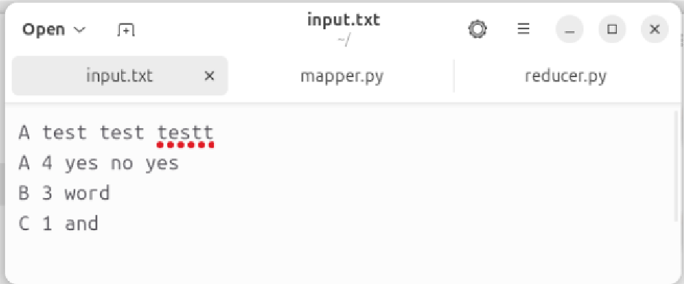
Step 7 – Try MapReducer in Ubuntu
Test the word count MapReducer on a local file.

Slide 26
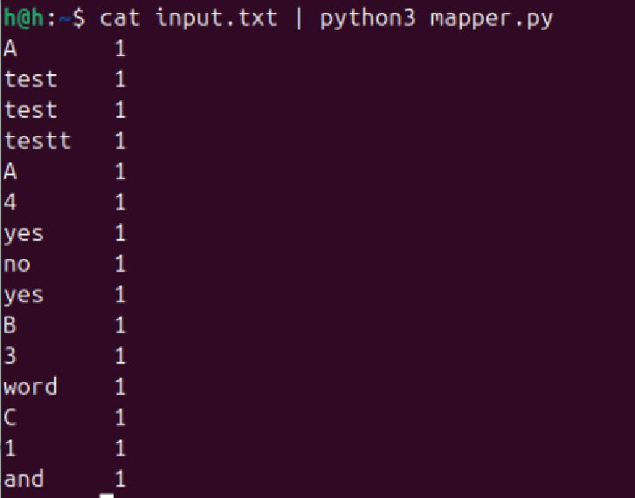
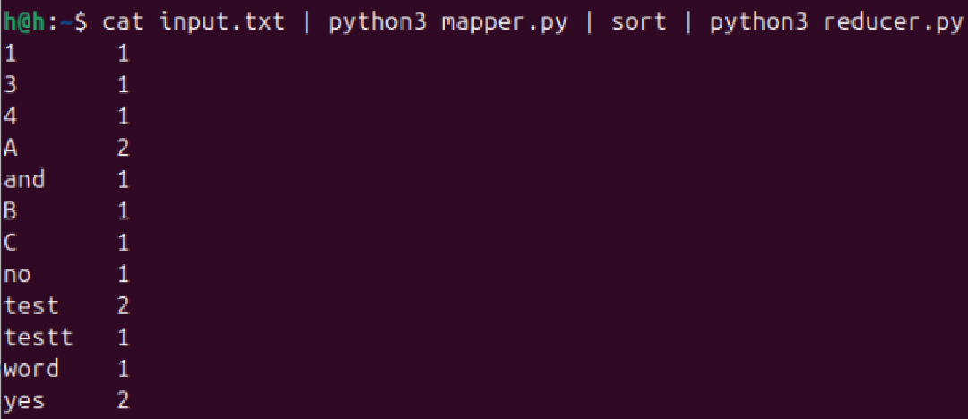
chmod +x mapper.py reducer.py

Slide 27
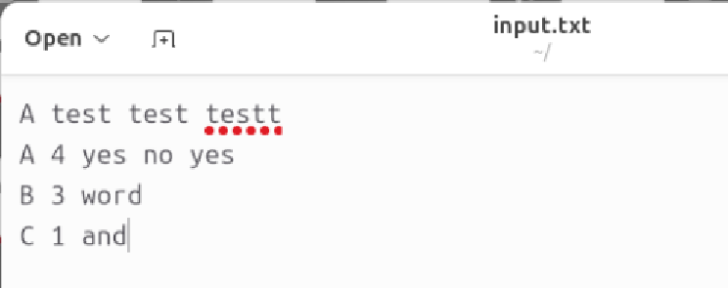
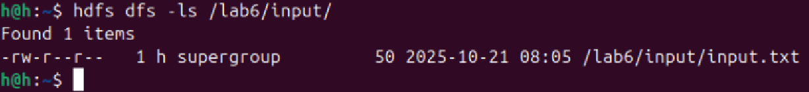
Step 8 – Try MapReducer in Hadoop
Pay attention to the space between commands!
hdfs dfs -mkdir /lab6
hdfs dfs -mkdir /lab6/input
hdfs dfs -put input.txt /lab6/input
hdfs dfs -ls /lab6/input/
Upload the sample file to Hadoop

Slide 28
Step 8 – Try MapReducer in Hadoop
hadoop jar $HADOOP_HOME/share/hadoop/tools/lib/hadoop-streaming-3.4.1.jar \
-input /lab6/input \
-output /lab6/output \
-mapper mapper.py \
-reducer reducer.py \
-file mapper.py \
-file reducer.py
Run the word count MapReducer in Hadoop via Streaming

Slide 29

Check the file path in file explorer
Run the word count MapReducer in Hadoop via Streaming

Slide 30
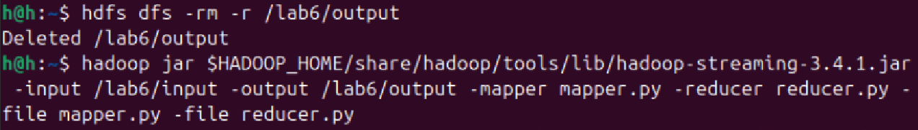
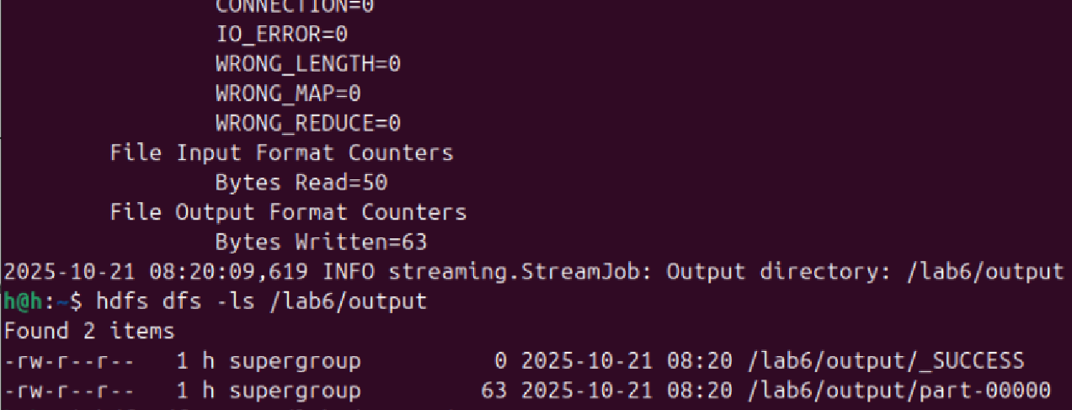
(Make sure the output path doesn’t exist)
Run the word count MapReducer in Hadoop via Streaming

Slide 31
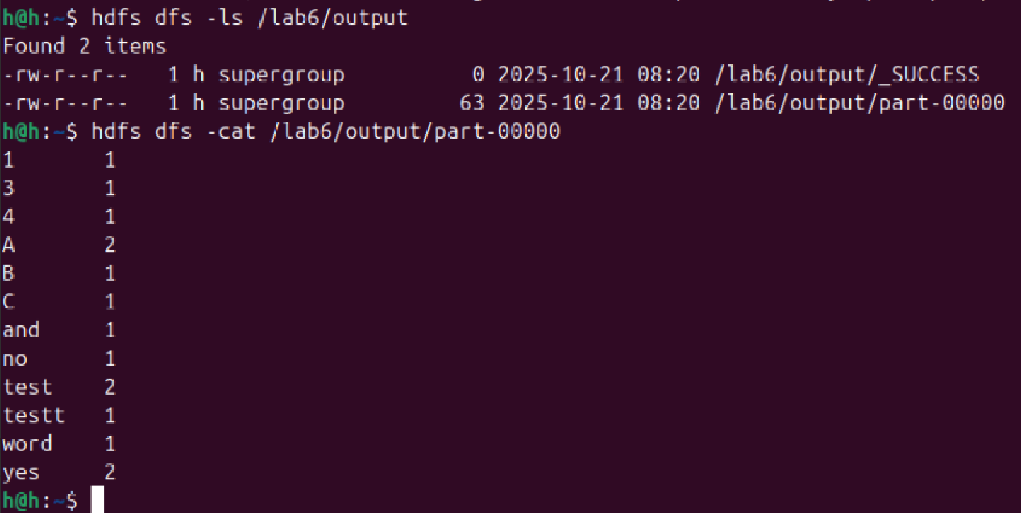
Run the word count MapReducer in Hadoop via Streaming

Slide 32
Step 9 – Try More MapReducer in Hadoop
We have tried the word count function with MapReducer in Python, you can try the following advanced practice if still have time:
Average by Key
Max per Category
IP Visit Count
Inverted Index

Slide 33
Step 9 – Try More MapReducer in Hadoop
Average by Key
  Calculate the average score for each user
  Input case:
alice,80
bob,90
alice,70
bob,100
alice 75.00
bob 95.00

Slide 34
#!/usr/bin/env python3
import sys
current_user = None
total = 0
count = 0
for line in sys.stdin:
user, score = line.strip().split('\t')
score = float(score)
if user == current_user:
total += score
count += 1
else:
if current_user:
print(f"{current_user}\t{total/count:.2f}")
current_user = user
total = score
count = 1
if current_user:
print(f"{current_user}\t{total/count:.2f}")
#!/usr/bin/env python3
import sys
for line in sys.stdin:
user, score = line.strip().split(',')
print(f"{user}\t{score}")

Slide 35
Step 9 – Try More MapReducer in Hadoop
Max per Category
  Find the maximum price for each product category
  Input case:
book 20
book 15
pen 3
pen 5
book 20.0
pen 5.0

Slide 36
#!/usr/bin/env python3
import sys
for line in sys.stdin:
category, price = line.strip().split()
print(f"{category}\t{price}")
#!/usr/bin/env python3
import sys
current_cat = None
max_price = float('-inf')
for line in sys.stdin:
cat, price = line.strip().split('\t')
price = float(price)
if cat == current_cat:
max_price = max(max_price, price)
else:
if current_cat:
print(f"{current_cat}\t{max_price}")
current_cat = cat
max_price = price
if current_cat:
print(f"{current_cat}\t{max_price}")

Slide 37
Step 9 – Try More MapReducer in Hadoop
IP Visit Count
  Count the number of visits per IP
  Input case:
192.168.0.1 - - [10/Oct/2025:13:55:36] "GET /index.html"
192.168.0.2 - - [10/Oct/2025:13:55:40] "GET /contact.html"
192.168.0.1 - - [10/Oct/2025:13:55:50] "GET /index.html"
192.168.0.1 2
192.168.0.2 1

Slide 38
#!/usr/bin/env python3
import sys
import re
for line in sys.stdin:
match = re.match(r'^(\S+)', line)
if match:
ip = match.group(1)
print(f"{ip}\t1")
#!/usr/bin/env python3
import sys
current_ip = None
count = 0
for line in sys.stdin:
ip, value = line.strip().split('\t')
value = int(value)
if ip == current_ip:
count += value
else:
if current_ip:
print(f"{current_ip}\t{count}")
current_ip = ip
count = value
if current_ip:
print(f"{current_ip}\t{count}")

Slide 39
Step 9 – Try More MapReducer in Hadoop
Inverted Index
  Establish an index structure of "in which files the word appears“
  Input case:
Hadoop file1.txt,file2.txt
Python file3.txt
fast file1.txt
flexible file3.txt
is file1.txt,file2.txt,file3.txt
scalable file2.txt
file1.txt: Hadoop is fast
file2.txt: Hadoop is scalable
file3.txt: Python is flexible

Slide 40
#!/usr/bin/env python3
import sys
import os
for line in sys.stdin:
# Hadoop streaming automatically provides filename in the environment
filename = os.environ.get('map_input_file', 'unknown')
for word in line.strip().split():
print(f"{word}\t{filename}")
#!/usr/bin/env python3
import sys
current_word = None
files = set()
for line in sys.stdin:
word, filename = line.strip().split('\t')
if word == current_word:
files.add(filename)
else:
if current_word:
print(f"{current_word}\t{','.join(sorted(files))}")
current_word = word
files = {filename}
if current_word:
print(f"{current_word}\t{','.join(sorted(files))}")
filename = os.environ.get('mapreduce_map_input_file', 'unknown’)
(in Python>=3.8)

Slide 41
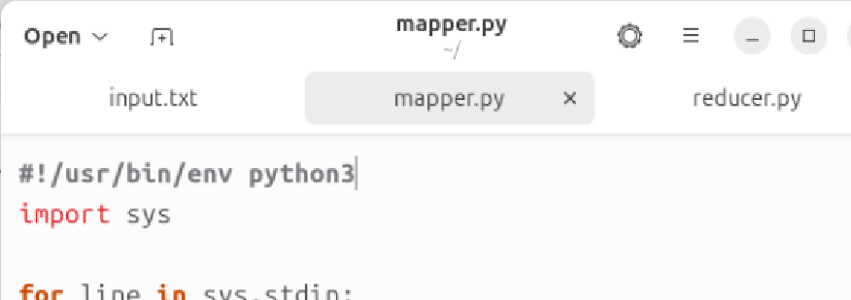
Common Errors and Fixes
💥 output path exist? → remove existing path
🛑 mapper.py: 1: import: not found? → set Python path
❓ Unexpected output? → Check Linux command and typo

Slide 42
Common Errors and Fixes
Normally, the problem is caused by missing any steps or wrong commands input.
Let me know if it still occurs after repeating all operations.

Slide 43
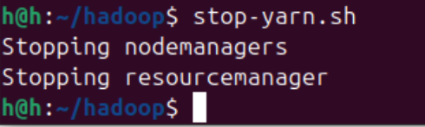
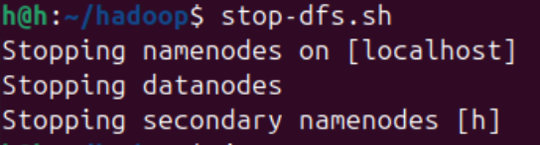
Step 10 – Finish the Practice
If you finished all practices, you can stop the Hadoop service by:
1) stop-yarn.sh
2) stop-dfs.sh

Slide 44
Summary
✅ You now have:
  Virtualized Ubuntu system
  Working Hadoop environment
  Map Reduce test on Hadoop

